Slide 1
CONSTRUCTION ADMINISTRATION
REVIT University
AFTER THE PERMIT….
ORB UNIVERSITY – 11,15 2023 PRESENTED BY Andres Fernandez

Slide 2
CONSTRUCTION ADMINISTRATION
VOCABULARY:
RFI: REQUEST FOR INFORMATION
ASK, SK: ARCHITECTURAL SKETCH
ASI: ARCHITECTS SUPLEMENTAL INFORMATION
DELTA Δ: NOTED UPDATES IN CONSTRUCTION DOCUMENTS RELATED TO A SPECIFIC ITEM AND DATE.
FIELD REPORTS: SNAPSHOT IN TIME OF PROJECT PROGRESS
SUBMITTALS: DOCUMENTS PROVIDED BY THE CONTRACTOR TO ORB FOR AN APPROVAL OF USE
SUBTITUTION REQUEST: CHANGES IN PRODUCTS, MATERIALS, EQUIPMENT, AND METHODS OF CONSTRUCTION REQUIRED BY CONTRACT DOCUMENTS PROPOSED BY CONTRACTOR
CYA: COVER YOUR ASSETS

Slide 3
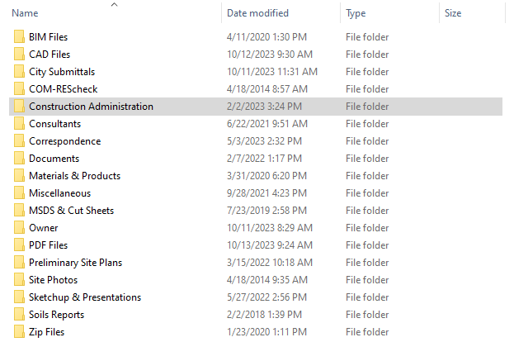
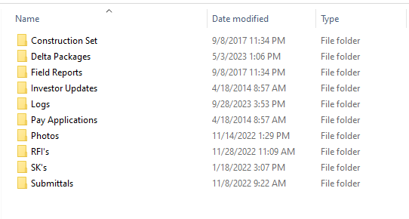
CONSTRUCTION ADMINISTRATION

Slide 4
CONSTRUCTION ADMINISTRATION
FIELD REPORTS:
DOCUMENTATION BY ORB OF FIELD CONDITIONS – A SNAPSHOT IN TIME OF PROJECT PROGRESS

Slide 5
CONSTRUCTION ADMINISTRATION
FIELD REPORTS

Slide 6
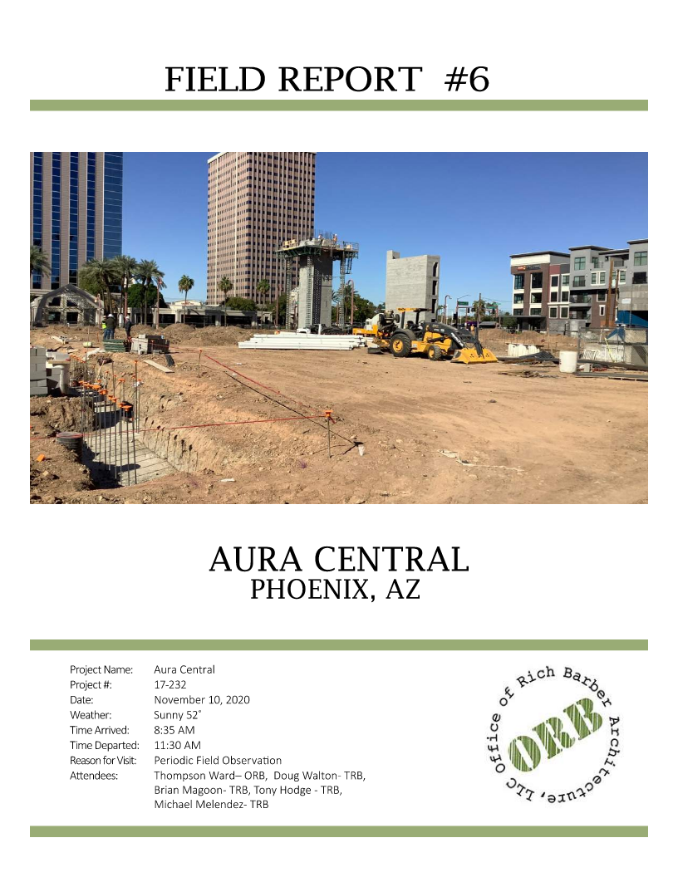
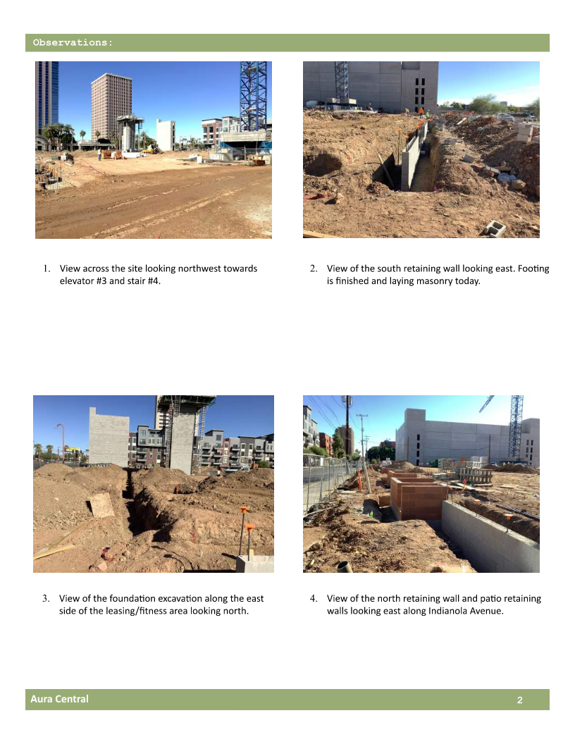
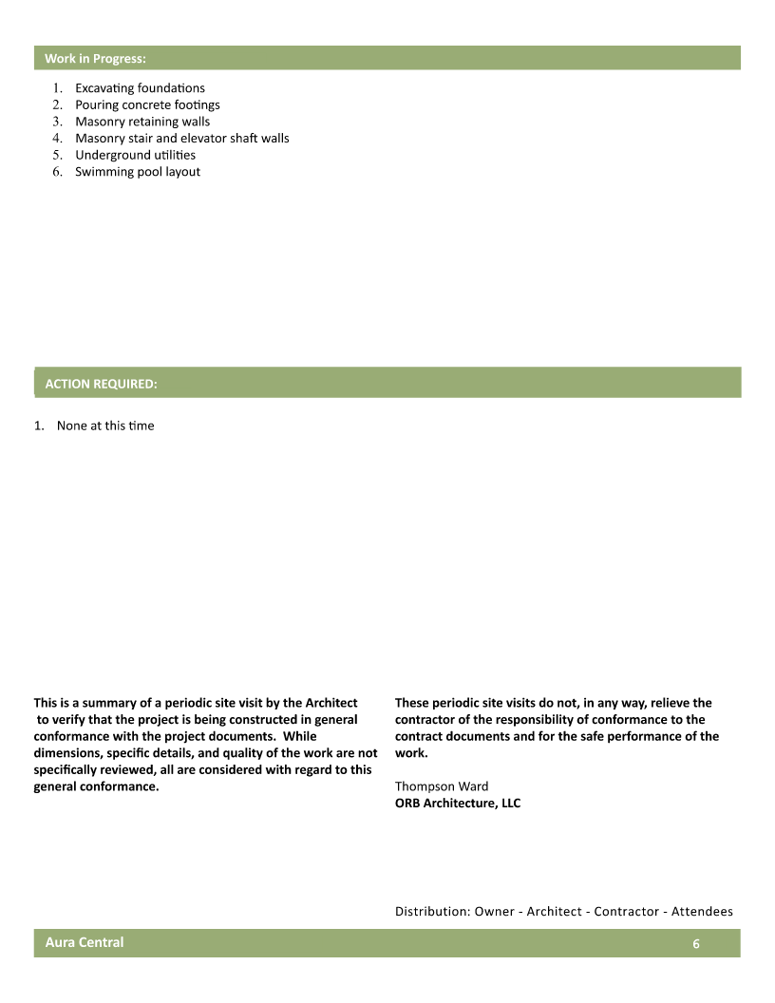
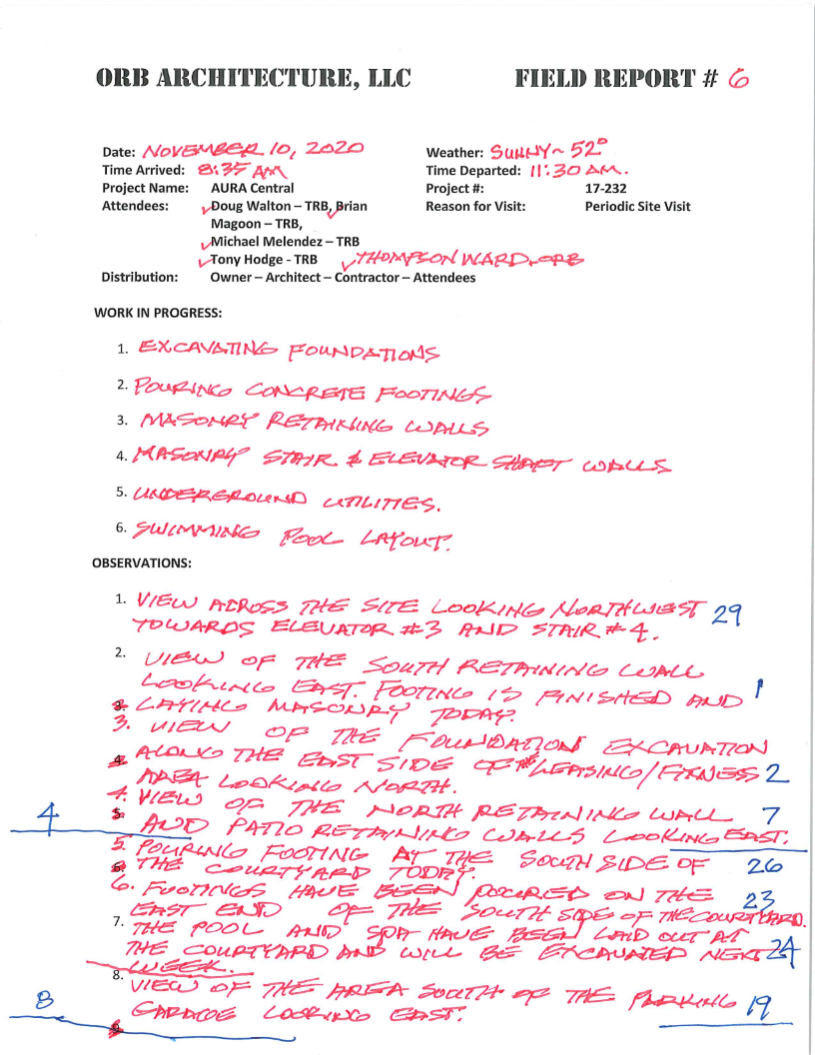
FIELD REPORTS

Slide 7
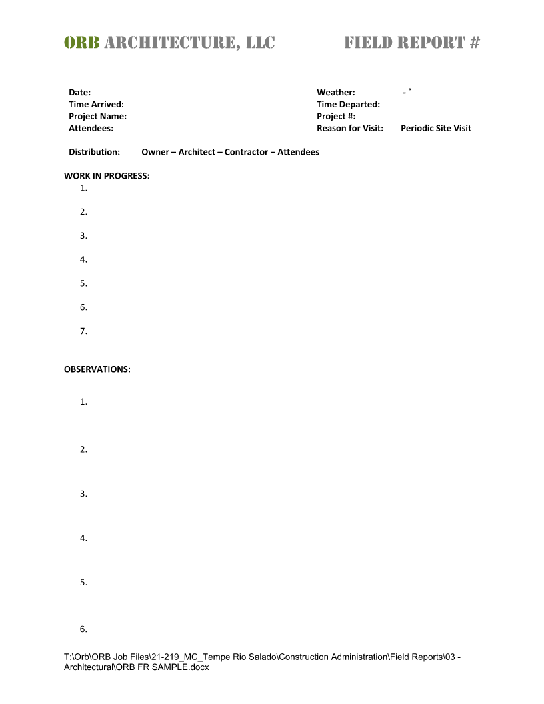
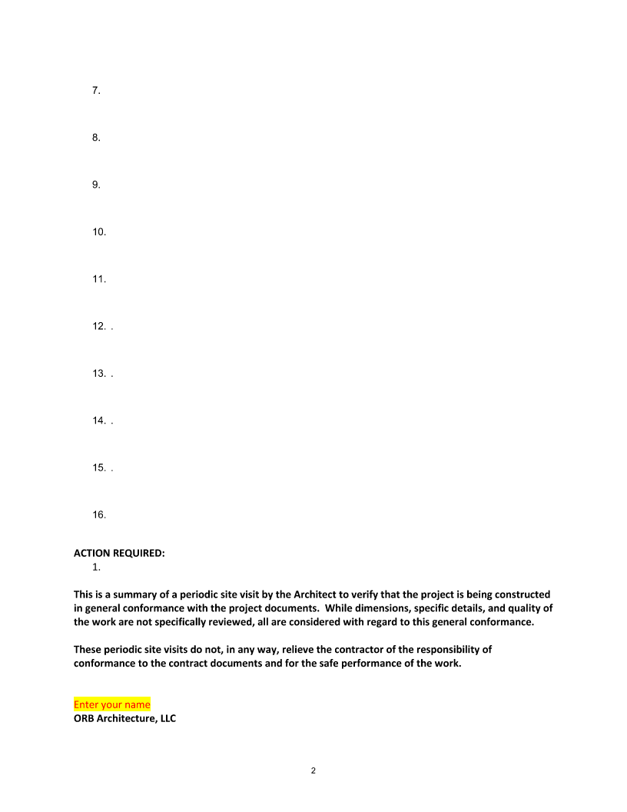
FIELD REPORTS

Slide 8
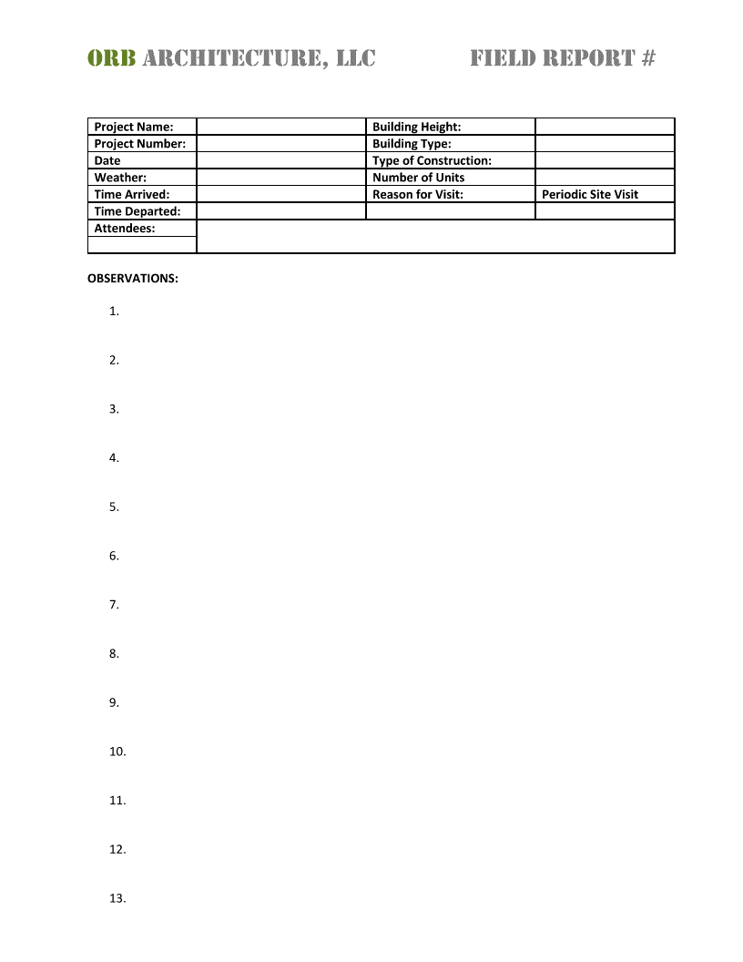
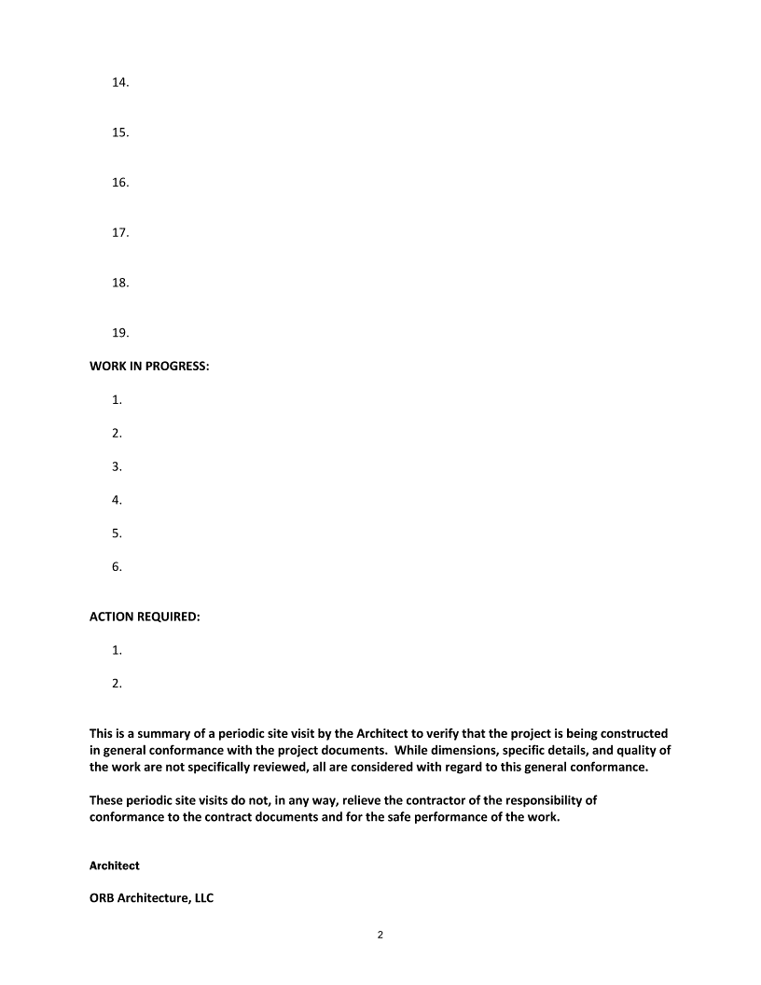
FIELD REPORTS

Slide 9
FIELD REPORTS

Slide 10
FIELD REPORTS
PHOTO 1 – STANDING NEAR NORTHEAST CORNER LOOKING SOUTHWEST
PHOTO 2 – VIEW OF THE SITE ENTRANCE, NEAR THE NORTHEAST CORNER OF THE SITE
PHOTO 3 – VIEW STANDING NEAR THE ON-SITE OFFICE TRAILERS LOOKING NORTH AT A STOCKPILE OF SOIL, JUST SOUTH OF THE ENTRANCE

Slide 11
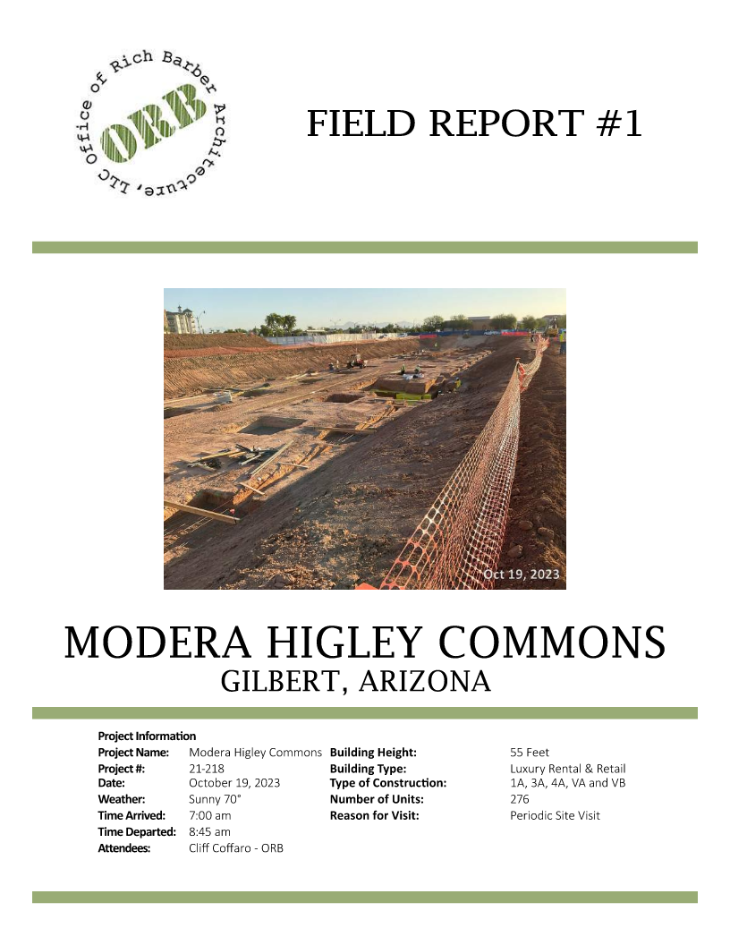
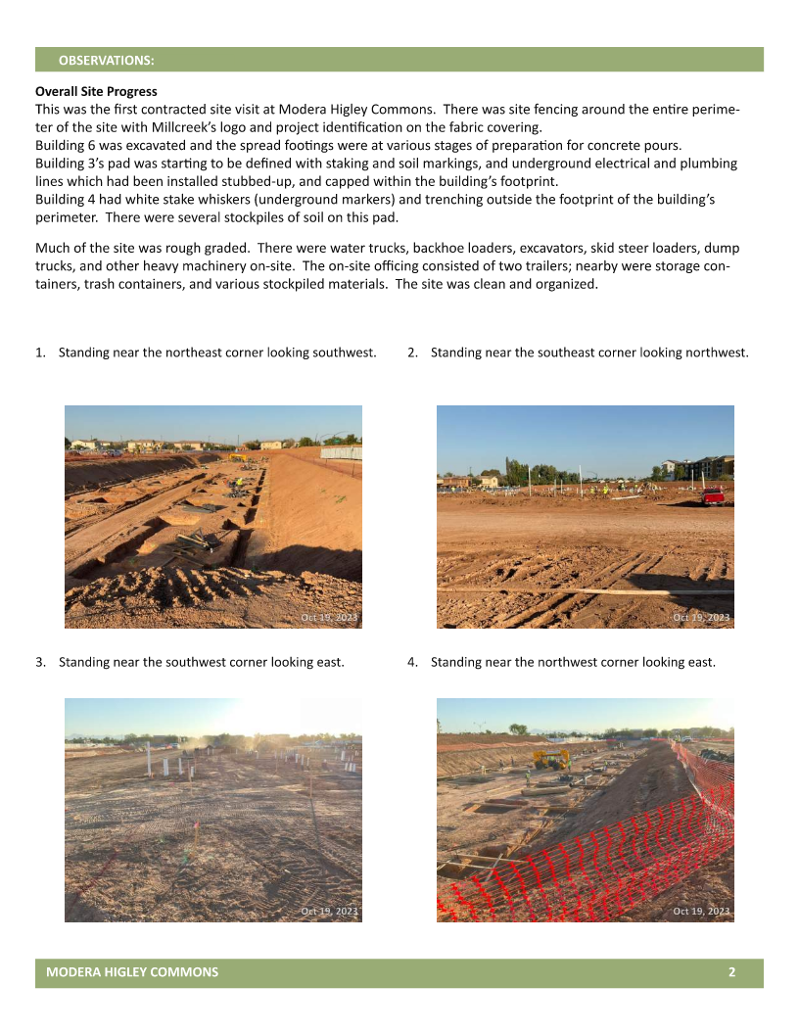
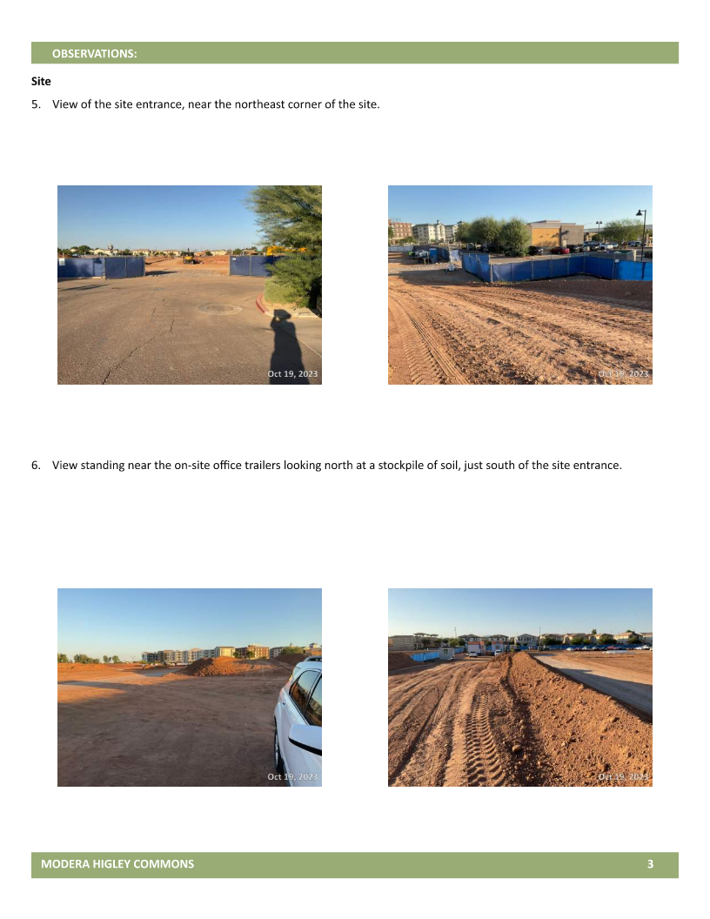
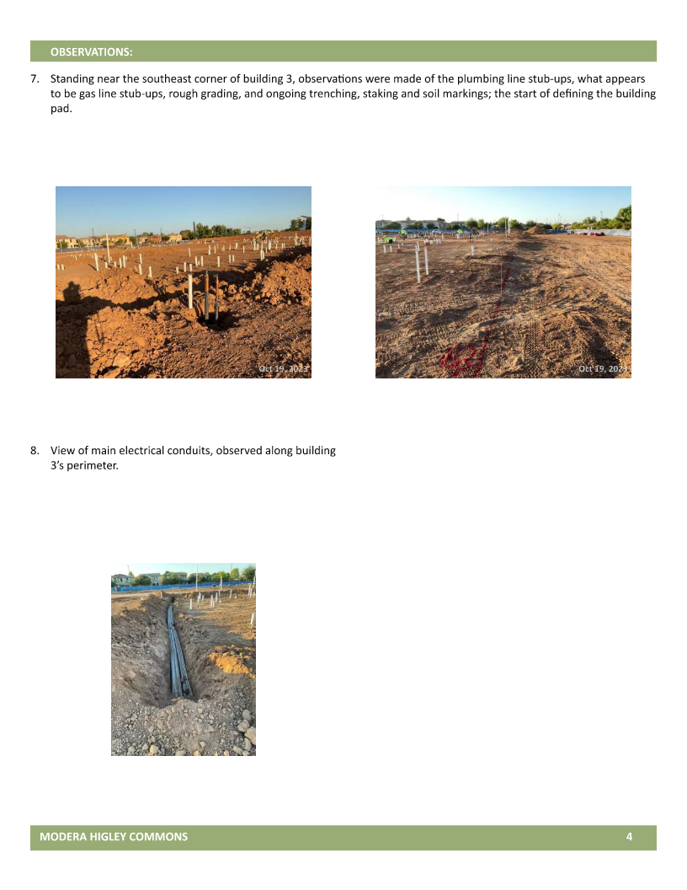
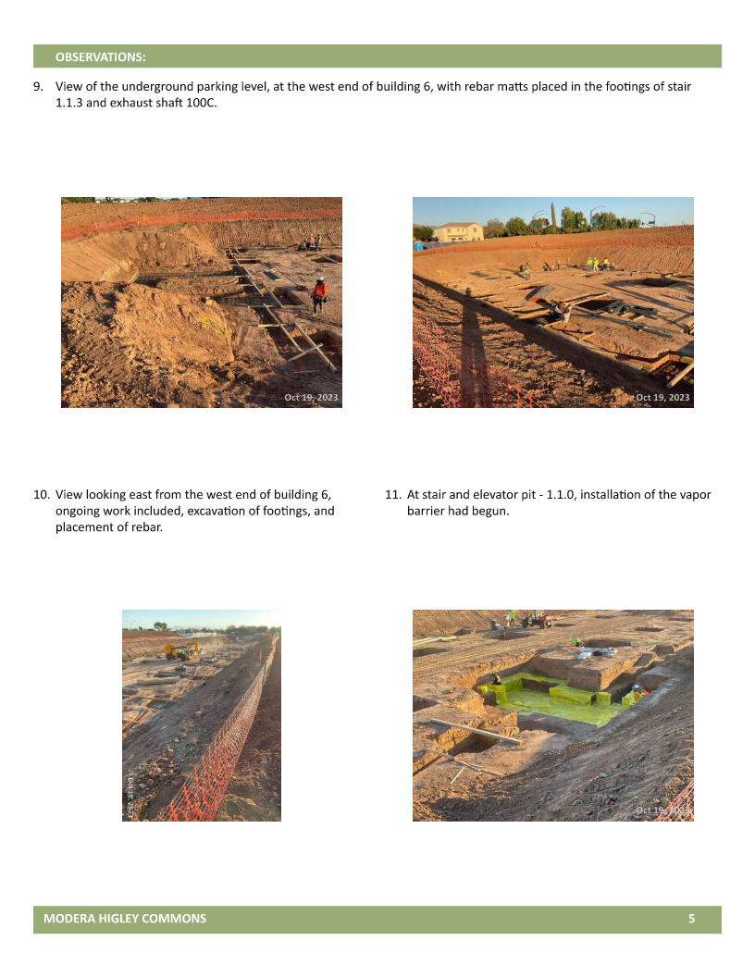
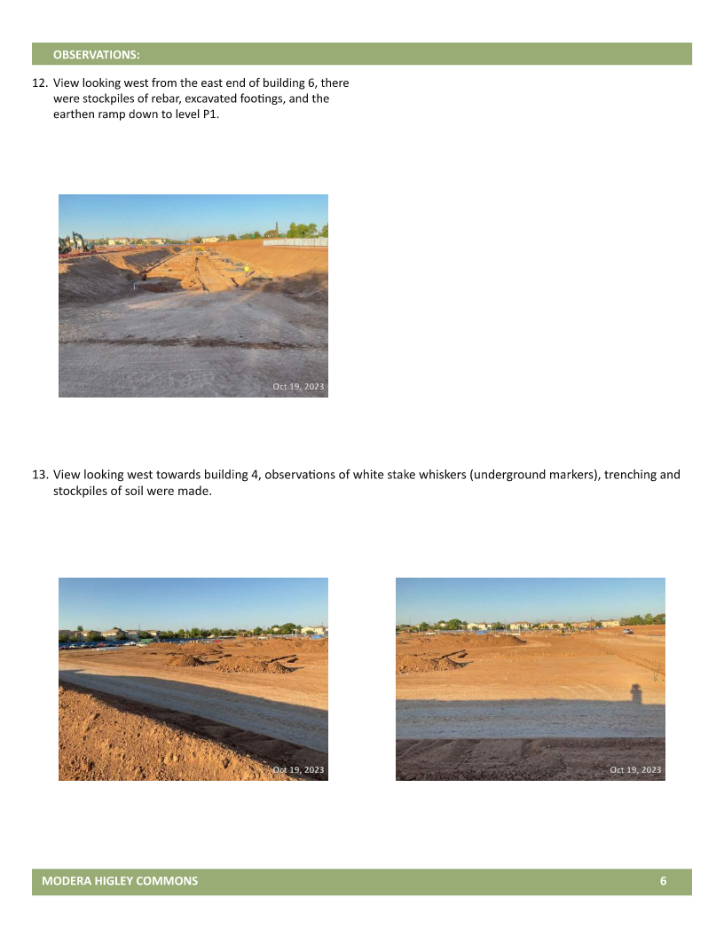
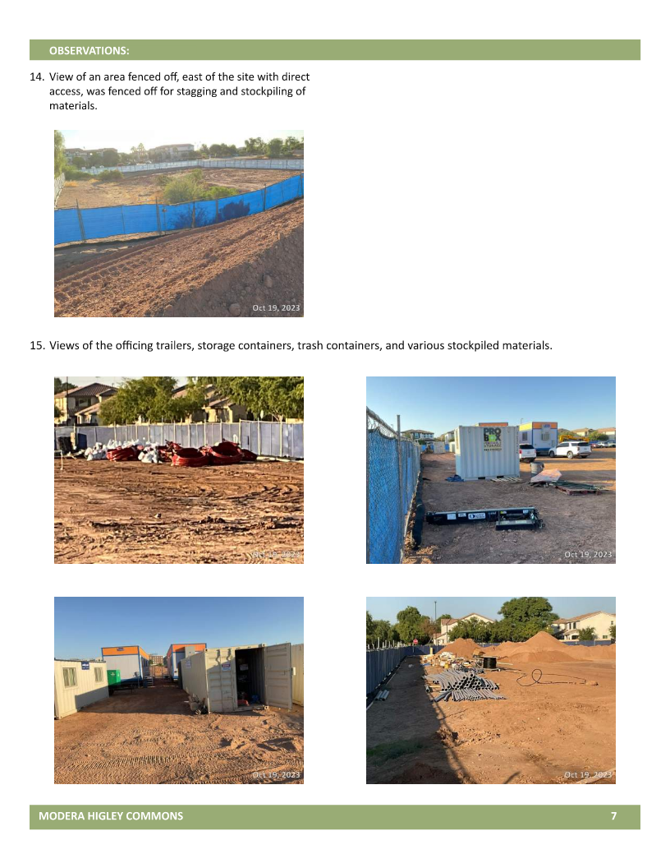
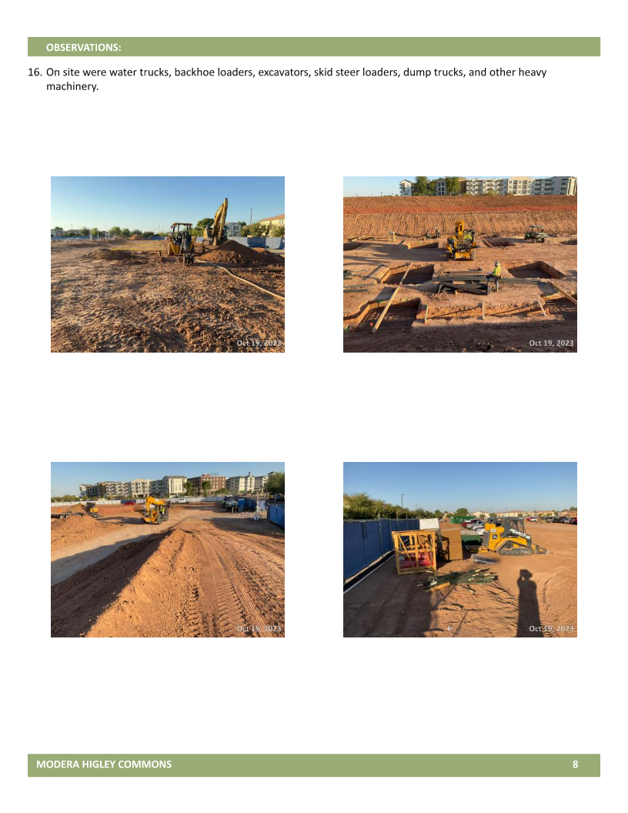
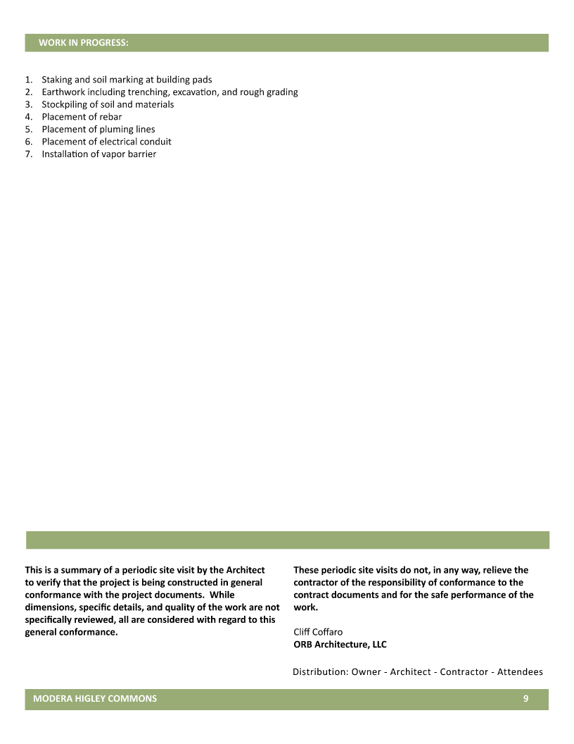
FIELD REPORTS
PHOTO 1 – STANDING NEAR NORTHEAST CORNER LOOKING SOUTHWEST
STAKING AND SOIL MARKING AT BUILDING PADS
PHOTO 2 – VIEW OF THE SITE ENTRANCE, NEAR THE NORTHEAST CORNER OF THE SITE
EARTHWORK INCLUDING TRENCHING, EXCAVATION, AND ROUGH GRADING
PHOTO 3 – VIEW STANDING NEAR THE ON-SITE OFFICE TRAILERS LOOKING NORTH AT A STOCKPILE OF SOIL, JUST SOUTH OF THE ENTRANCE
STOCKPILING OF SOIL AND MATERIALS
PLACEMENT OF REBAR

Slide 12
FIELD REPORTS
STAKING AND SOIL MARKING AT BUILDING PADS
EARTHWORK INCLUDING TRENCHING, EXCAVATION, AND ROUGH GRADING
STOCKPILING OF SOIL AND MATERIALS
PLACEMENT OF REBAR

Slide 13
FIELD REPORTS

Slide 14
FIELD REPORTS

Slide 15
FIELD REPORTS

Slide 16
FIELD REPORTS

Slide 17
FIELD REPORTS
THE FOLLOWING IS A COLLECTION OF ORB : CA STAFF “GO TO LANGUAGE”
When writing field reports be brief but clear. Add location/reference to the plans.
“shall be”
“approximately”
“observed” “observe”
“on-going”
“upper level”
“appears to be”
“does not appear to be” per documents
“generally, appears to be” per documents
“G.C. to confirm”
“as it occurs”
“in all other applicable”
“is secure”
“Ensure”

Slide 18
FIELD REPORTS
THE FOLLOWING IS A COLLECTION OF ORB : CA STAFF “GO TO LANGUAGE”
When writing field reports be brief but clear. Add location/reference to the plans.
”are no more than“
”it is unclear “
“The work appears to be substantially complete”
“Including but not limited to”
“Verify compliance with field inspector”
“Install per manufactures written specifications”
“Otherwise agreed with the Owner/ per owner’s preference”
“Originally called for in the documents/plans”
“To the best of my knowledge”
“According to observable conditions at the site”
As architects we observe rather than inspect. We should use “shall be” rather than “may be”. We review submittals rather than approve them.

Slide 19
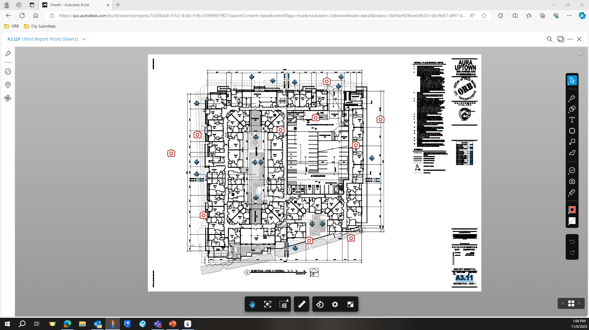
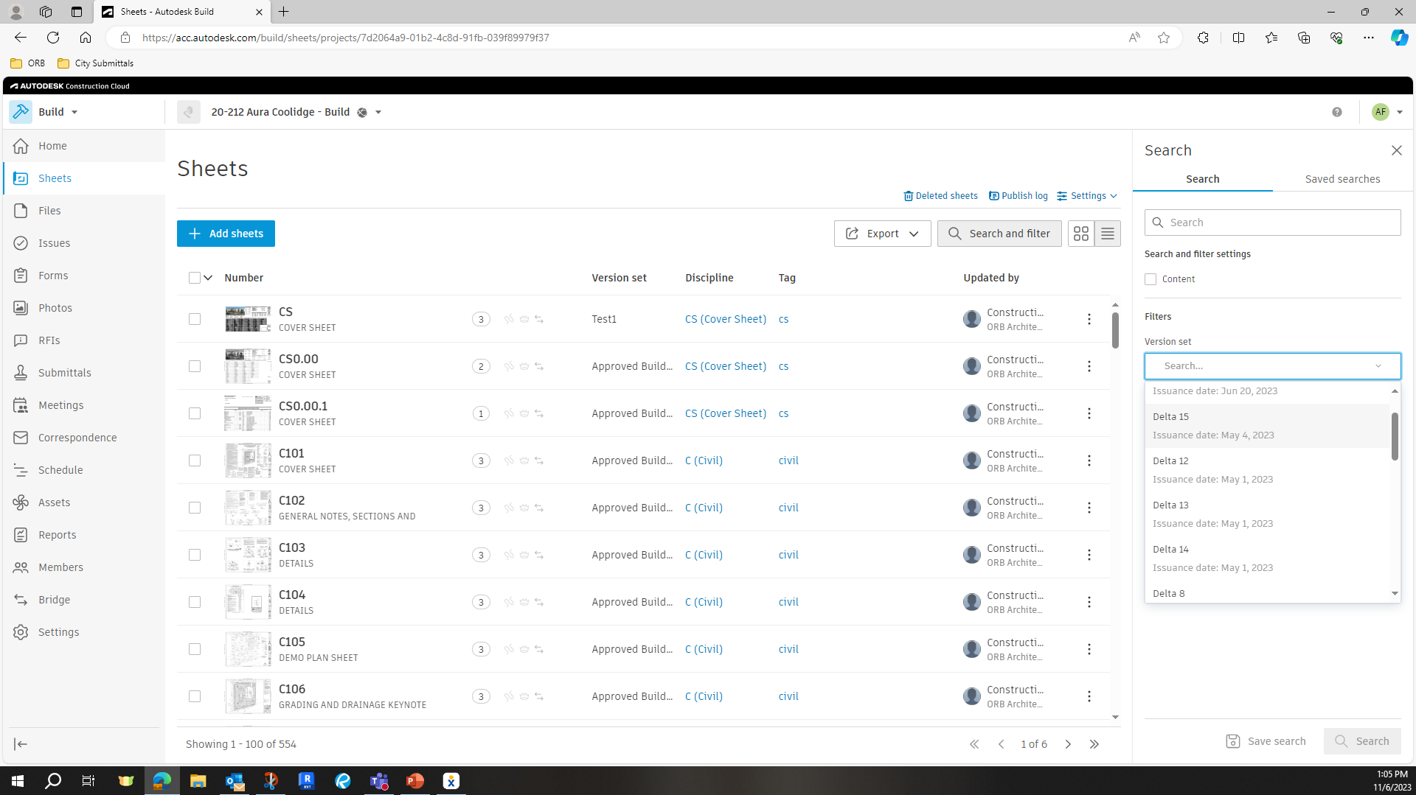
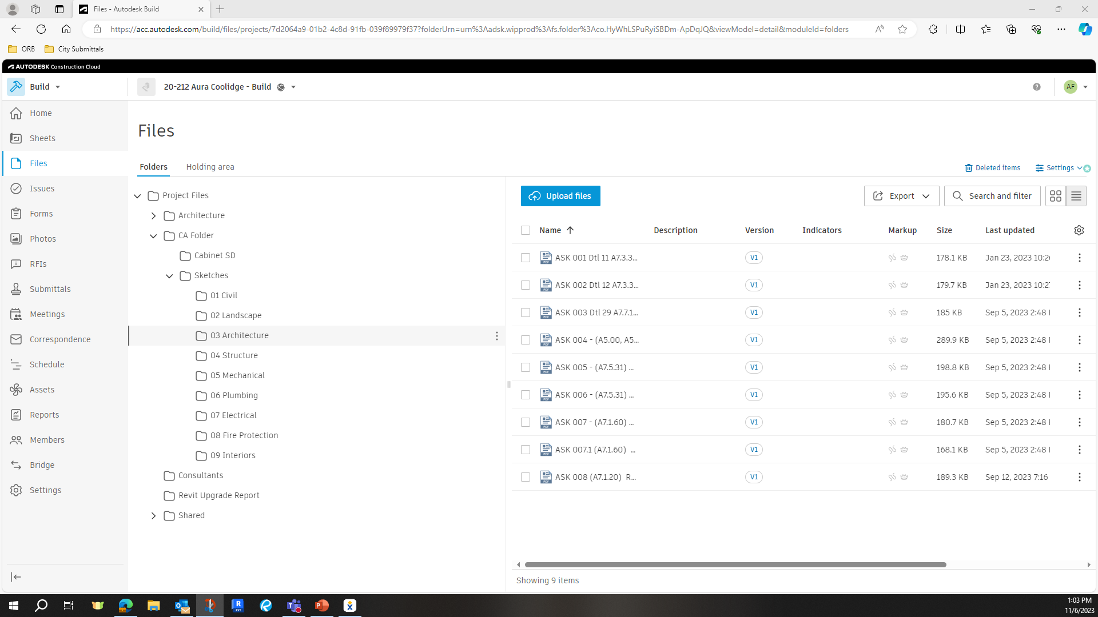
FIELD REPORTS

Slide 20
FIELD REPORTS

Slide 21
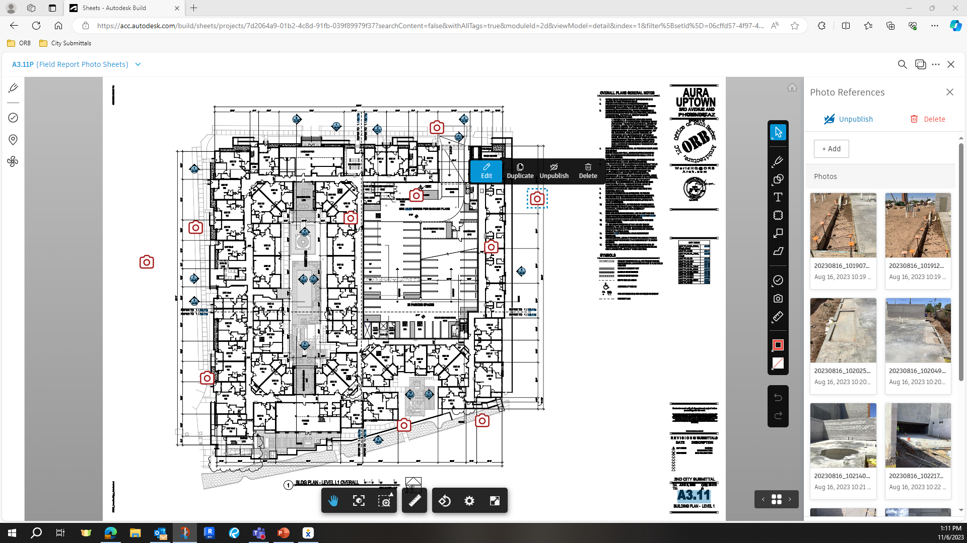
FIELD REPORTS

Slide 22
FIELD REPORTS
BE THOROUGH IN YOUR COMMENTS
NOTE THE ITEMS THAT CHANGED FROM YOUR LAST VISIT DOCUMENT THE PROGRESS (PHOTO)
PLAN YOUR VISIT AND WHAT YOU WILL INSPECT AHEAD OF TIME – COORDINATE WITH CONTRACTOR FOR ANY NEW DEVELOPMENT ON SITE
LANGUAGE IS IMPORTANT. NON-CONSTRUCTION PARTICIPANTS WILL READ THESE REPORTS WHEN USED FOR PAY-APPLICATIONS.
OUR ROLE IS TO OBSERVE, NOT INSPECT OR EVALUATE. USE NEUTRAL AND CONSISTENT LANGUAGE / TERMINOLOGY TO DESCRIBE PROGRESS
DOCUMENT DISCREPANCIES BETWEEN WHAT YOU FIND ON SITE AND THE CONSTRUCTION DOCUMENTS AND NOTIFY THE CONTRACTOR’S SUPERINTENDENT. FOLLOW UP WITH EMAIL / PHOTOS / CONVERSATION WITH CONTRACTOR

